Slide 1

Core Workshop 5: Convexity and Gradient Descent

Slide 2
OVERVIEW
Introduction to convexity
Introduction to gradient descent
Introduction to stochastic gradient descent

Slide 3

Optimisation
Savings – cost, time, energy
Training a neural network
Weights and biases
“the action of making the best or most effective use of a situation or resource”

Slide 4
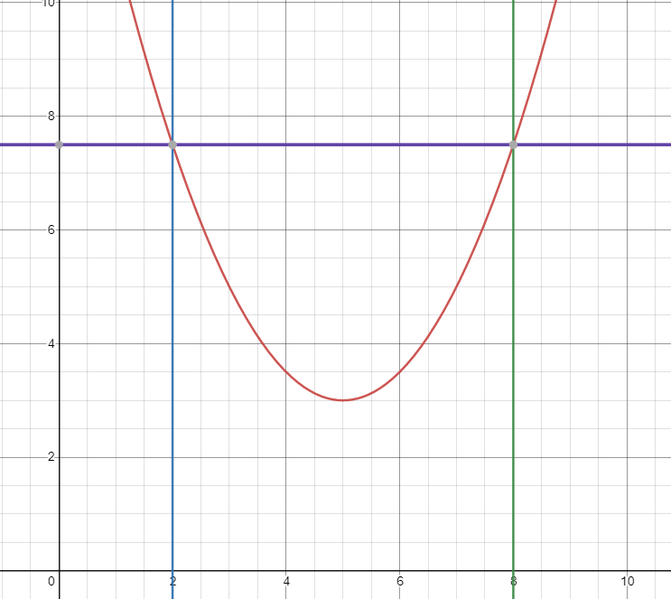
Convexity

Slide 5
Convexity
Points on the curve ≤ Points on the straight line
≤ → < Strictly convex

Slide 6
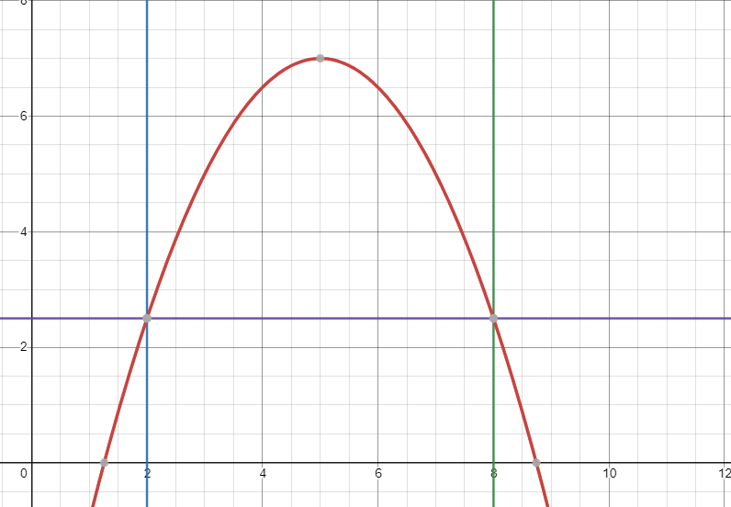
Concavity
Maximisation

Slide 7
A function that is convex and concave? A function that is neither convex or concave?

Slide 8
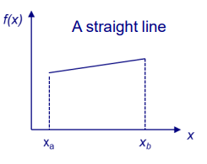
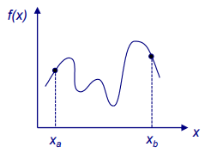
Points on the curve = Points on the straight line
Points on the curve lay above and below line

Slide 9
Why convexity is important
A Strictly convex or concave provides a single optimum
A non-convex function may have multiple local optimum
No method can guarantee a global optimum for a general non-convex function

Slide 10
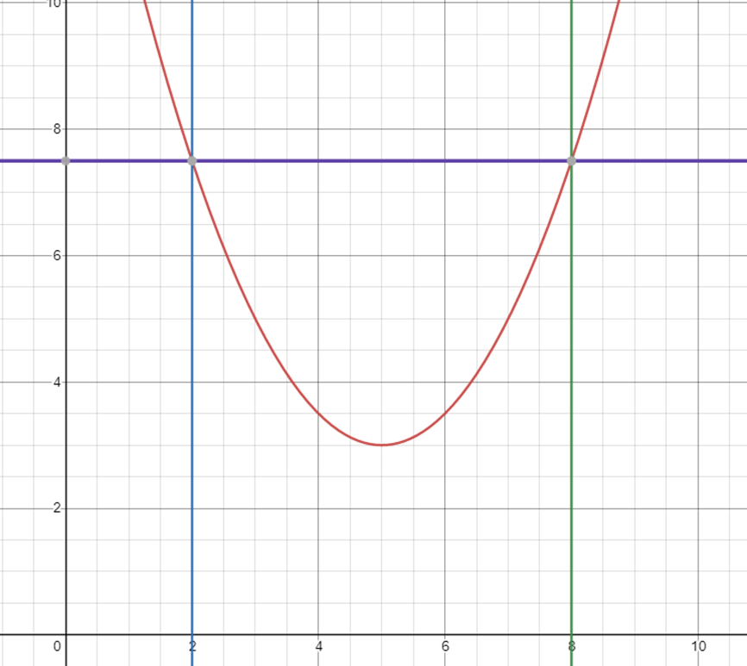
How to determine convexity
Draw a plot?

Slide 11
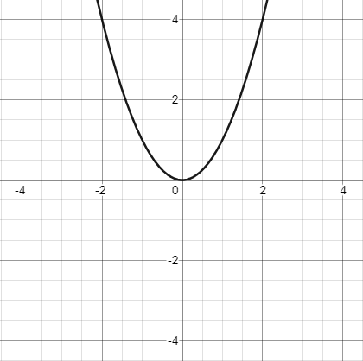
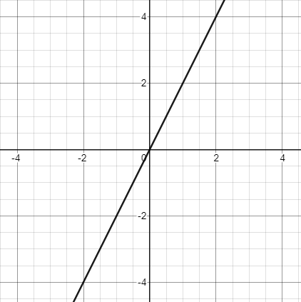
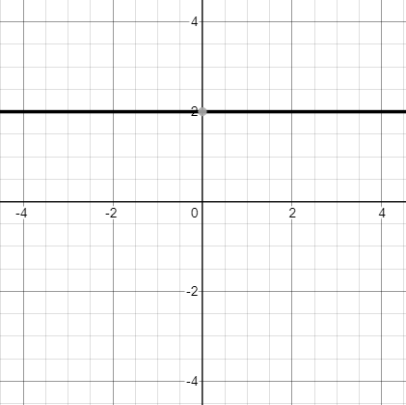
How to determine convexity
Use derivatives
f(x) = x²
f’(x) = 2x
f’’(x) = 2

Slide 12

What is a derivative
The rate of change of X with respect to the rate of change of Y
$$f^{′}\left(c\right)= \lim_{h→0}{\frac{f\left(c+h\right)−f(c)}{h}=\frac{∆x}{∆y}}$$

Slide 13
How to determine convexity
Use derivatives
f(x) = x²
f’(x) = 2x
Can be positive and negative
f’’(x) = 2
Always positive ∴ strictly convex

Slide 14
Conditions for convexity
f’’(x) ≥ 0 f(x) is convex
f’’(x) > 0 f(x) is convex
f’’(x) ≤ 0 f(x) is concave
f’’(x) < 0 f(x) is concave
If f’’(x) can be negative and positive then f(x) is indefinite

Slide 15
examples
f(x) = 3x²
f(x) = 2x
f(x) = -5x²
f(x) = 2x² – x³

Slide 16
examples
f’’(x) = 6 → strictly convex
f’’(x) = 0 → both convex and concave
f’’(x) = -10 → strictly concave
f’’(x) = 4 - 6x → indefinite

Slide 17
What about multivariable functions?

Slide 18
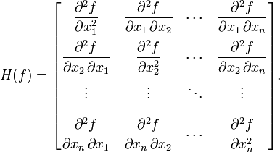
Hessian matrix
Hessian matrix represents the second derivative of a multivariable function
Hessian matrix is symmetrical

Slide 19
Conditions of convexity
x^{T}Hx ≥ 0 H(x) is positive semidefinite for all x
x^{T}Hx > 0 H(x) is positive definite for all x≠0
x^{T}Hx ≤ 0 H(x) is negative semidefinite for all x
x^{T}Hx < 0 H(x) is negative definite for all x≠0
x^{T}Hx is negative for some x and positive for other x is indefinite
x^{T}Hx is scalar
Eigenvalues

Slide 20
Gradient descent

Slide 21
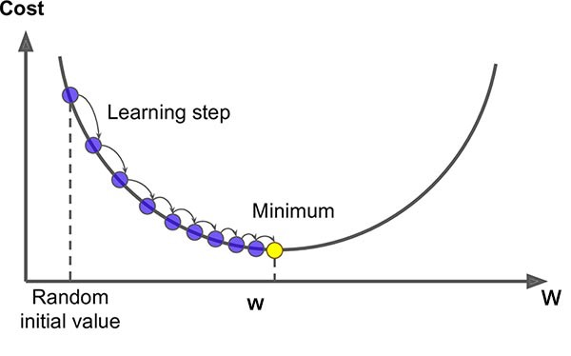
Gradient descent
Select values for parameters, an initial guess.
Take the derivative of the function
Evaluate the derivatives with the initial guesses
Calculate the step size. Step size = derivative of parameter × learning rate.
New parameter = old parameter – step size.
Repeat steps 3 - 5 until relative error is small enough or the maximum number of steps is reached.

Slide 22
Learning rate
SGD is sensitive to the value of the learning rate.
We start with a relatively large learning rate and make it smaller with each step.
Schedule: the way the learning rate changes from relatively large to small.
We do this so as it gets closer to the desired value it is less likely to an optimal solution

Slide 23
Code example

Slide 24
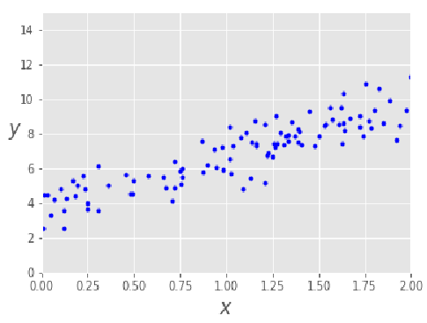
Gradient descent
Generate data
X = 2 * np.random.rand(100,1) y = 4 +3 * X+np.random.randn(100,1)

Slide 25
Gradient descent
Set initial guess
m = len(y)
loss_history = np.zeros(iterations)
theta_history = np.zeros((iterations,2))

Slide 26
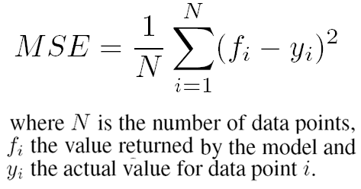
Gradient descent
Evaluate derivative
(1/n) *( X.T.dot((prediction - y)))
Loss
2

Slide 27
Gradient descent
Calculate step size
step_size = learning_rate* (1/m)*( X.T.dot((prediction - y)))
Learning rate = 0.01

Slide 28
Gradient descent
Calculate new parameter
theta = theta – step_size

Slide 29
Def gradient_descent(X,y,theta,learning_rate=0.01,iterations=1000):
m = len(y)
cost_history = np.zeros(iterations)
theta_history = np.zeros((iterations,2))
for it in range(iterations): #error < E
prediction = np.dot(X,theta)
step_size = learning_rate*(1/m)*( X.T.dot((prediction - y)))
theta = theta - step_size
theta_history[it,:] =theta.T
loss_history[it] = cal_loss(theta,X,y)
#error = (theta - step_size) - theta return theta, cost_history, theta_history
return theta, theta_history, loss history

Slide 30
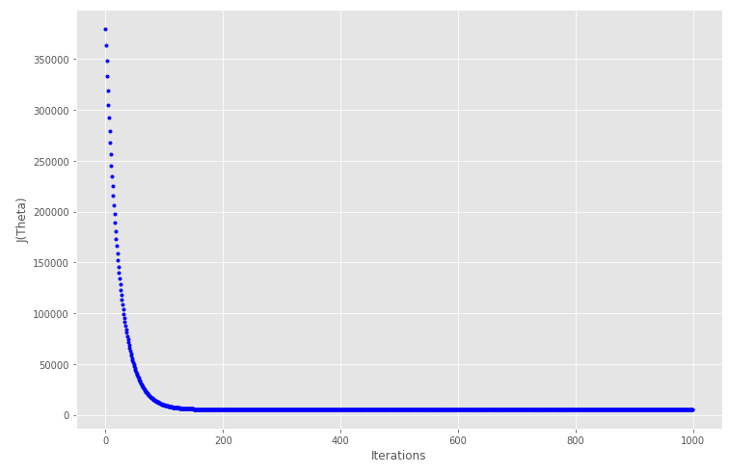

Slide 31
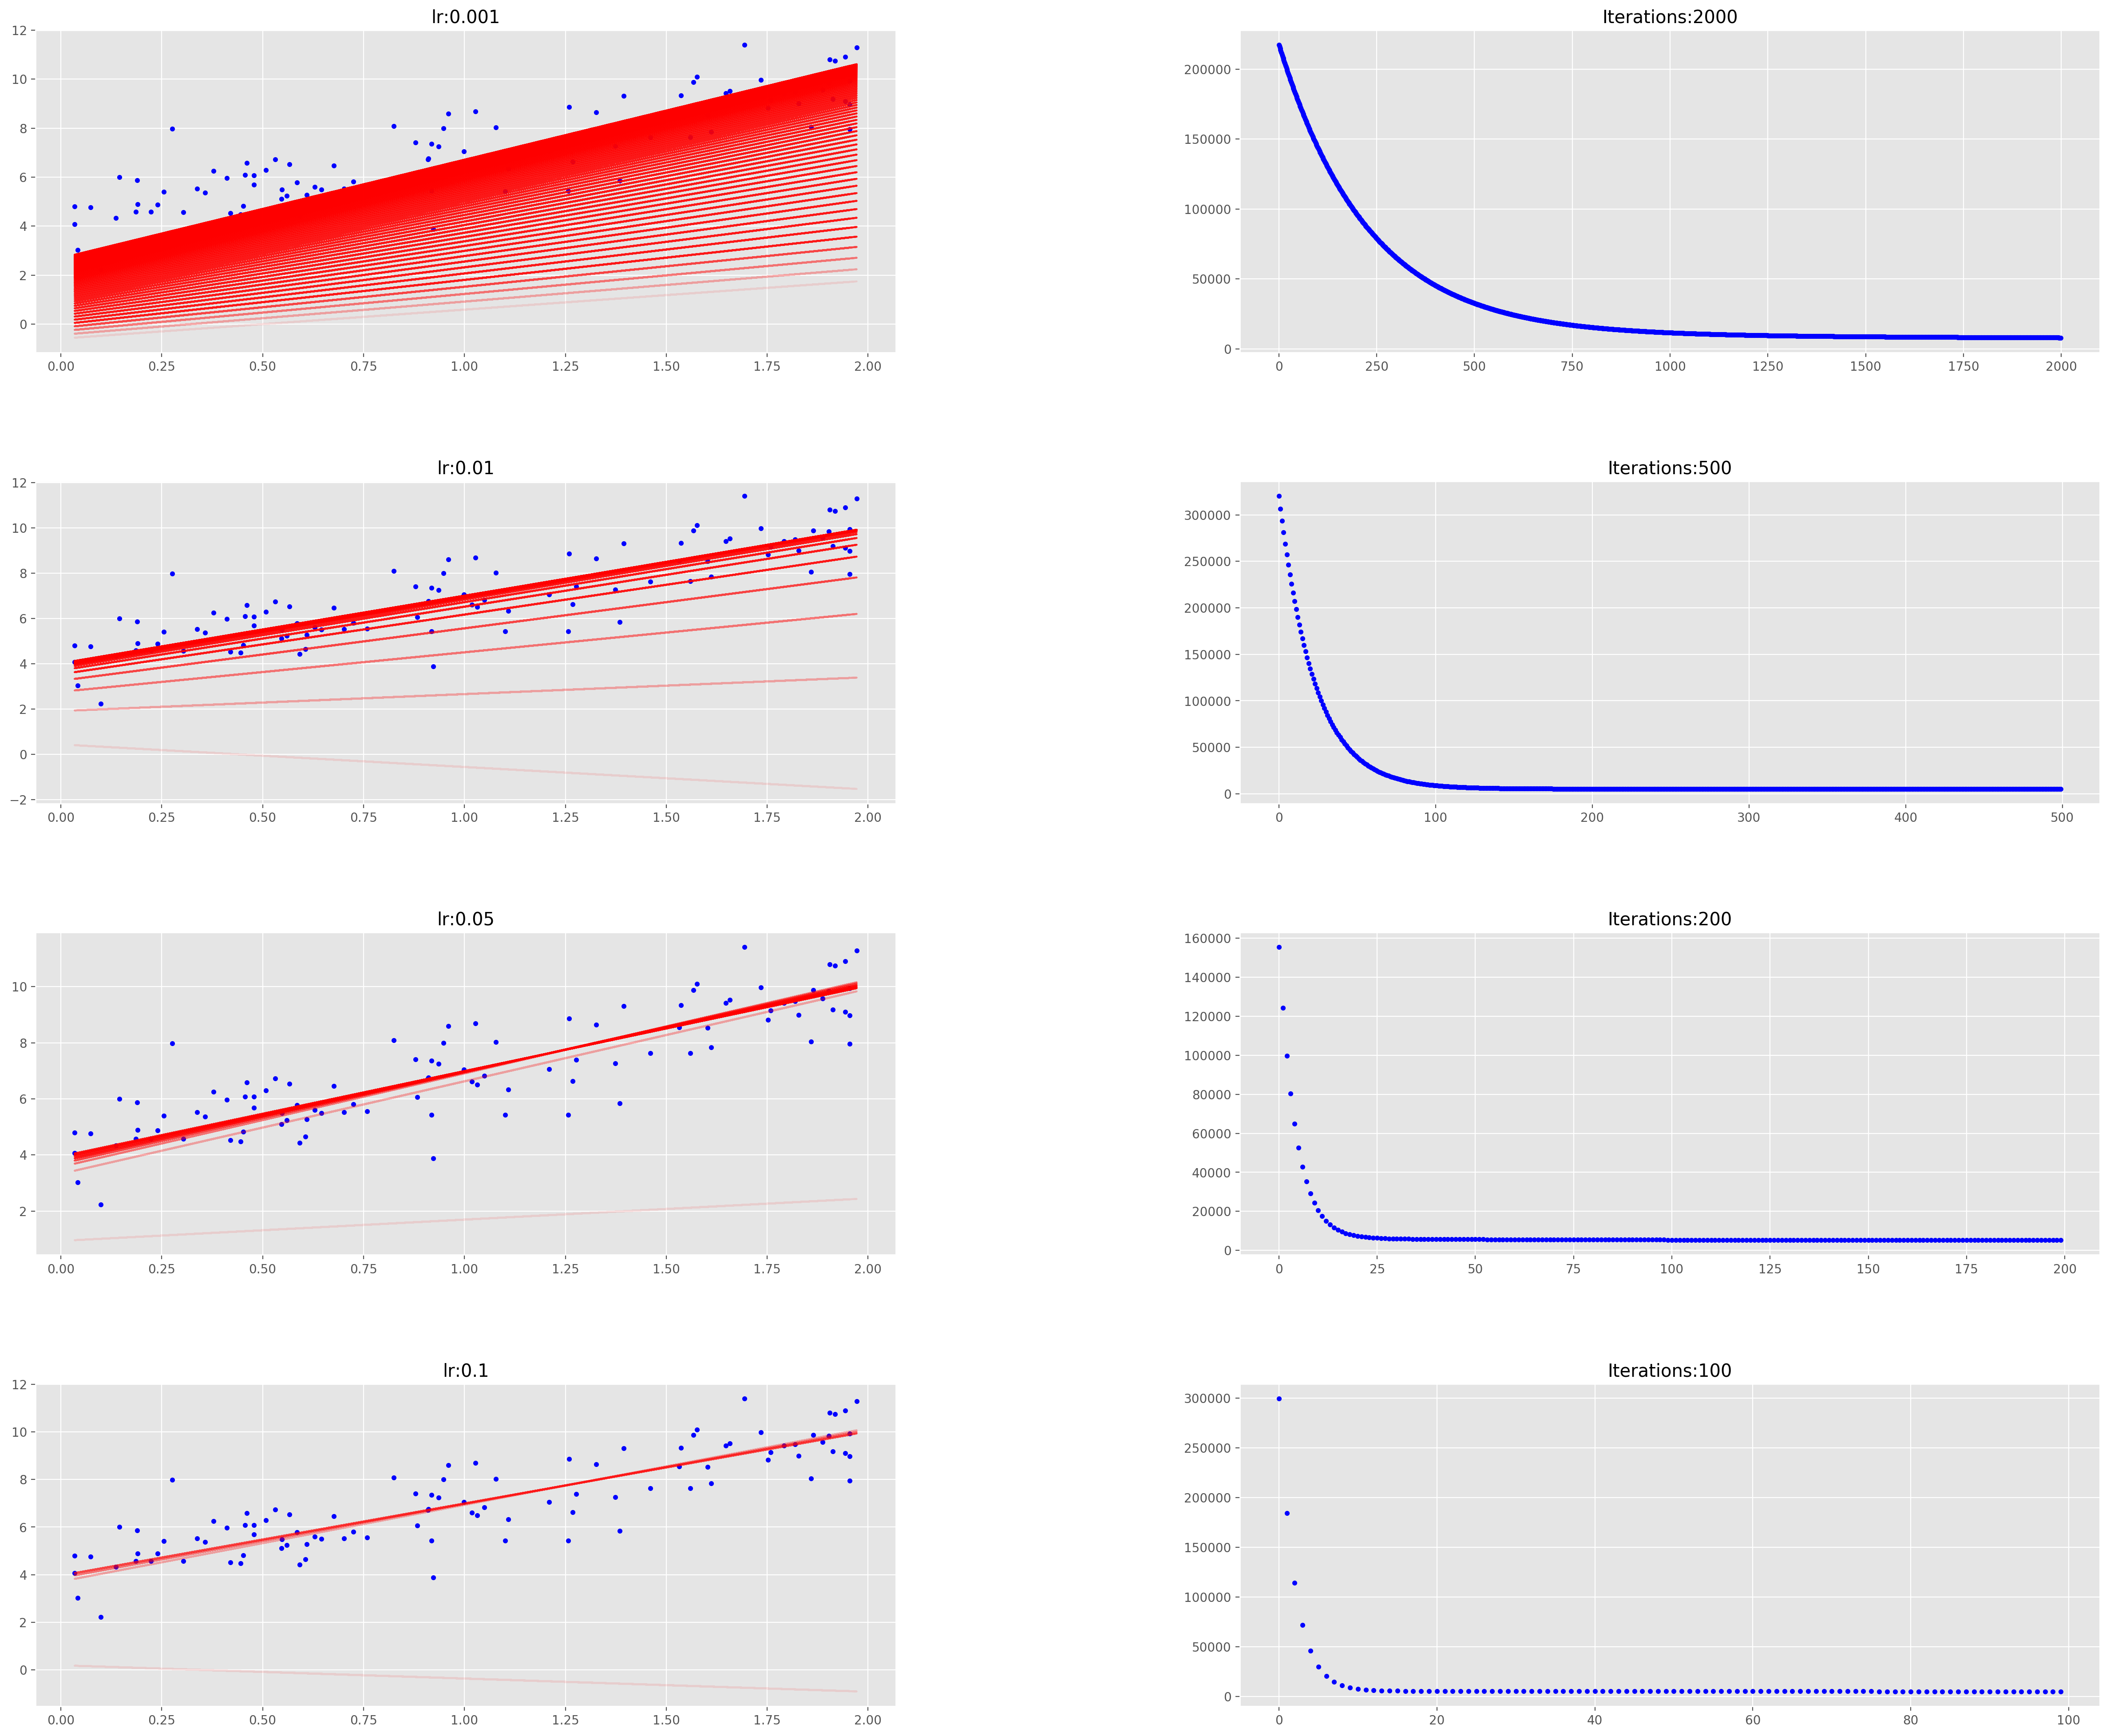

Slide 32
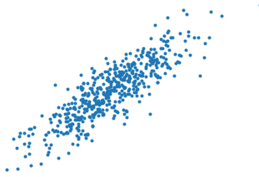
What is stochastic gradient descent
Strictly speaking it is the same algorithm as gradient descent, however uses 1 randomly selected point at a time.
This reduces computing cost as there are far fewer calculations required.

Slide 33
Why would we use stochastic gradient descent?
We are using logistic regression that uses 23,000 genes to predict if someone will get a disease.
With 1 million samples and a maximum iteration value of 1000.
23,000 derivatives.
1,000,000 terms.
23,000,000,000 terms per step.
23,000,000,000,000 terms to calculate.
For big data use stochastic gradient descent.

Slide 34
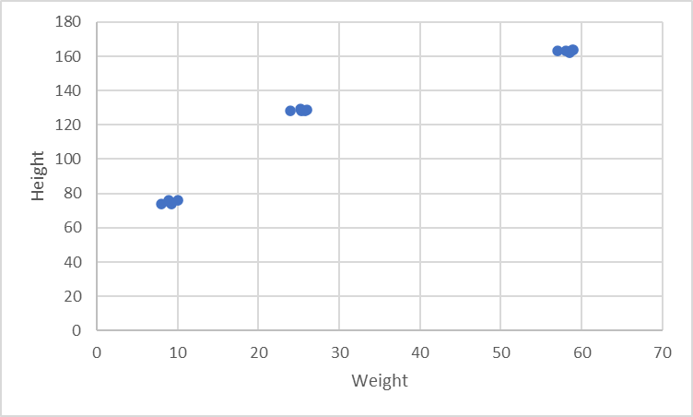
Mini batch
Mini batch is a version of SGD that utilises multiple data subsets.
Its very useful when there are redundancies within your data e.g. clusters.
It selects a random point from each of the subsets and uses those with each step.

Slide 35
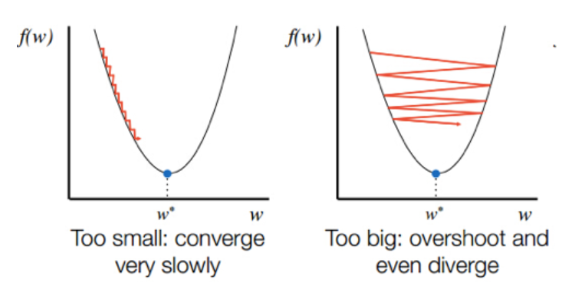
Pros | Cons
A lot quicker computationally than simple gradient descent. when new data gets added, we can use that data point to take another step, there is no need to start from scratch. | There might be outliers within the dataset which can cause bias and lead to less accurate results. Sensitivity to learning rate
Can be alleviated using momentum.

